Slide 1
Module 1: Lesson 6:
Azure Storage Services Quick Start

Slide 2







About The Presenter
Mahmoud A. ATALLAH
Sr. Solution Architect / Bespin Global MEA. Over 10 years of experience
Dad, Technologies Geek, Blogger, Speaker, #ArWVDUG Community Founder
Helping customers to accelerate their Cloud Journey and Digital Transformation
Main Focus: Remote Working Solutions and Related Services, AVD (WVD), W365.
Collaborating with expertise in producing content and solutions to make IT life easier
3tallah.com/blog

Slide 3


Lesson 6: Overview - Azure Storage services
This lesson will cover
Introduction
Usage Benefits
Azure Blob Storage
Azure File Storage
Azure Queue Storage
Azure Table Storage
Azure Disk Storage
Find the right storage type for your needs
Demo: Creating Your First Azure Storage Account
Demo: Creating different Storage types and exploring Usage needs
Demo: Delete a Storage Account and clearing the Environment
Prepare for The Exam(Q/A)

Slide 4

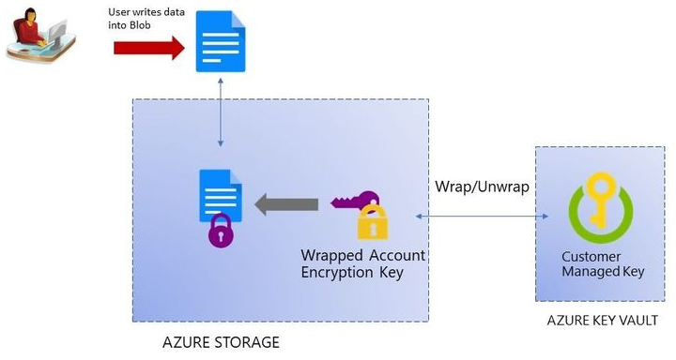
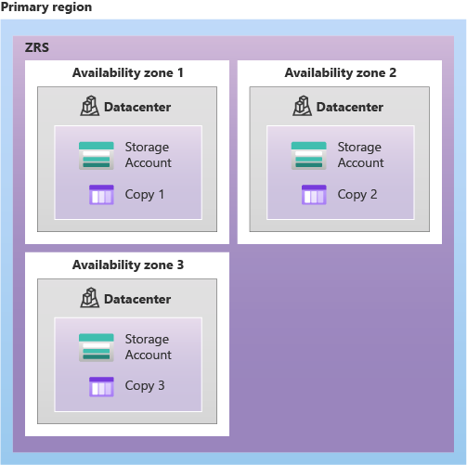



What is Azure Storage?
Azure Storage is one of the fundamental pieces of Microsoft cloud technology. They contain all of our Azure Storage data like object, file, disk, queue, and table storage.
There are also services for hybrid storage solutions, and services to transfer, share, and back up data.

Slide 5
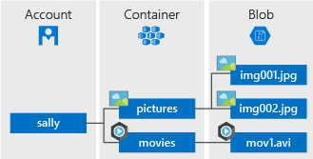

Azure Blob Storage
Blobs typically include large files that are unstructured, such as images, video, music files, backup files, etc.
Blob storage can be divided into three access tiers
Hot access tier
Cold access tier
Archive tier

Slide 6
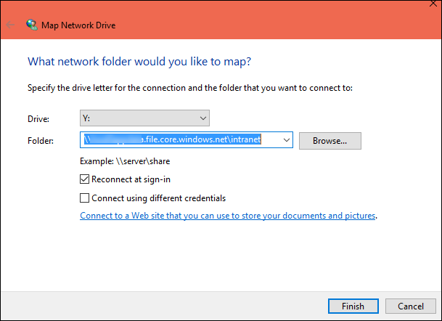

Azure File Storage
Offers fully managed file sharing on the cloud and its shares can be accessed using the standard (SMB) protocol.
Meaning that multiple virtual machines can share the same files with read and write access just like a local network share
Notes:
\

Slide 7
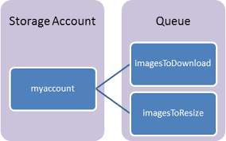

Azure Queue Storage
Provides asynchronous message queuing for communication between azure components whether they are on the cloud on-prem or even mobile devices
It's used to store and retrieve messages. Queues and messages can be created programmatically or using the Storage Explorer

Slide 8
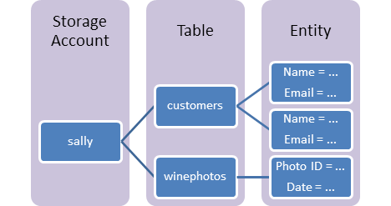
Azure Tables Storage
Massive auto-scaling NoSQL store
Dynamic scaling based on load
Scale to PBs of table data
Fast key/value lookups

Slide 9
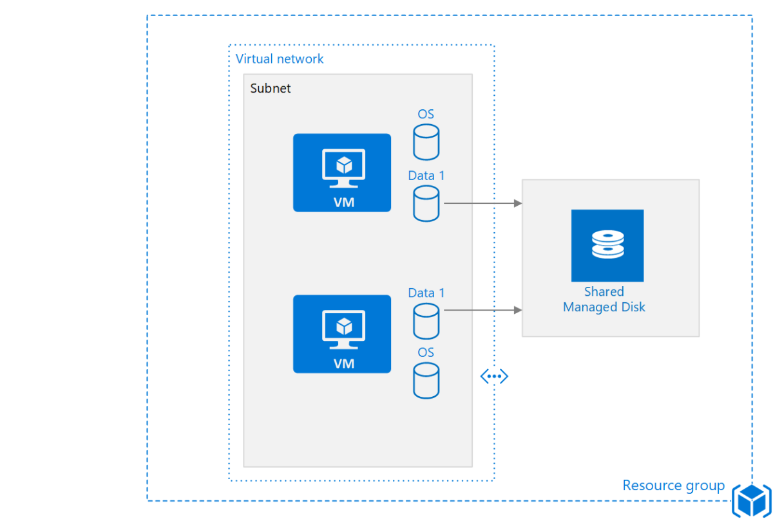

Azure Disk Storage
Azure offers two types of disk storage:
Managed and Unmanaged
And multiple types of disks performance:
Standard HDD
Standard SSD
Premium SSD
Ultra disk

Slide 10
Find the right storage type for your needs
IF YOU WANT | USE THIS
High-performance, durable block storage for Azure Virtual Machines | Azure Disk Storage
Massively scalable and secure object storage for cloud-native workloads, archives, data lakes, high-performance computing | Azure Blob Storage
Simple, secure, and serverless enterprise-grade cloud file shares | Azure Files
Enterprise file storage, powered by NetApp | Azure NetApp Files

Slide 11


Module 1: Lesson 6: Demo 1:
Creating Your First Azure Storage Account

Slide 12
Module 1: Lesson 6: Demo 2:
Creating different Storage types and exploring Usage needs

Slide 13
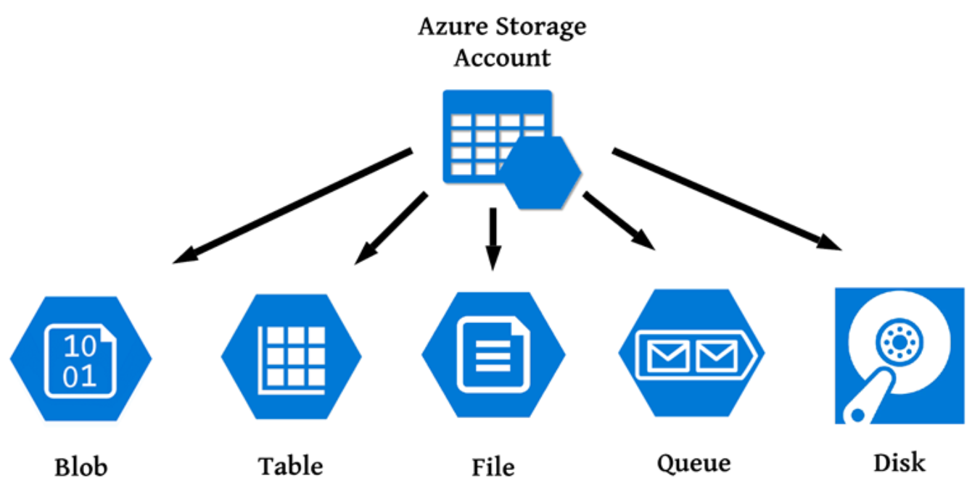
Module 1: Lesson 6: Demo 2:
Creating different Storage types and exploring Usage needs

Slide 14
Module 1: Lesson 6: Demo 3:
Explore Azure Storage using Management and Tools

Slide 15





Prepare for The Exam (Q/A)
Types of unstructured data include:
JSON and XML file
SQL databases
Media files
You need to access your storage account using a private IP address. How can you configure this?
Configure Storage Account routing.
Configure a Service Endpoint.
Configure Virtual Gateway
Configure the Storage Account firewall.

Slide 16
Azure Active Directory Domain Services.
Prepare for The Exam (Q/A)
You have been asked to help an Organization in modernizing its file-sharing solution using Azure.
Ensuring file-sharing data is stored in Azure storage
Providing accessibility over SMB to end-users
Support Active Directory authentication and NTFS
You need to identify a service that meets these needs. Which two services would you recommend?
Azure Active Directory Conditional Access.
Azure Blob Storage.
Active Directory Domain Services.
Azure Files.

